Slide 1
Configuration of Excitatory-Inhibitory Timing

Slide 2
GOAL
We have a background inhibitory-GABA gamma rhythm acting on the soma. The excitatory synapses fire at the same rate as the background synapses (50Hz). We need to determine if the temporal synchronization of these signals (whether constructive or destructive) impacts the nonlinearity of the FS curve.

Slide 3
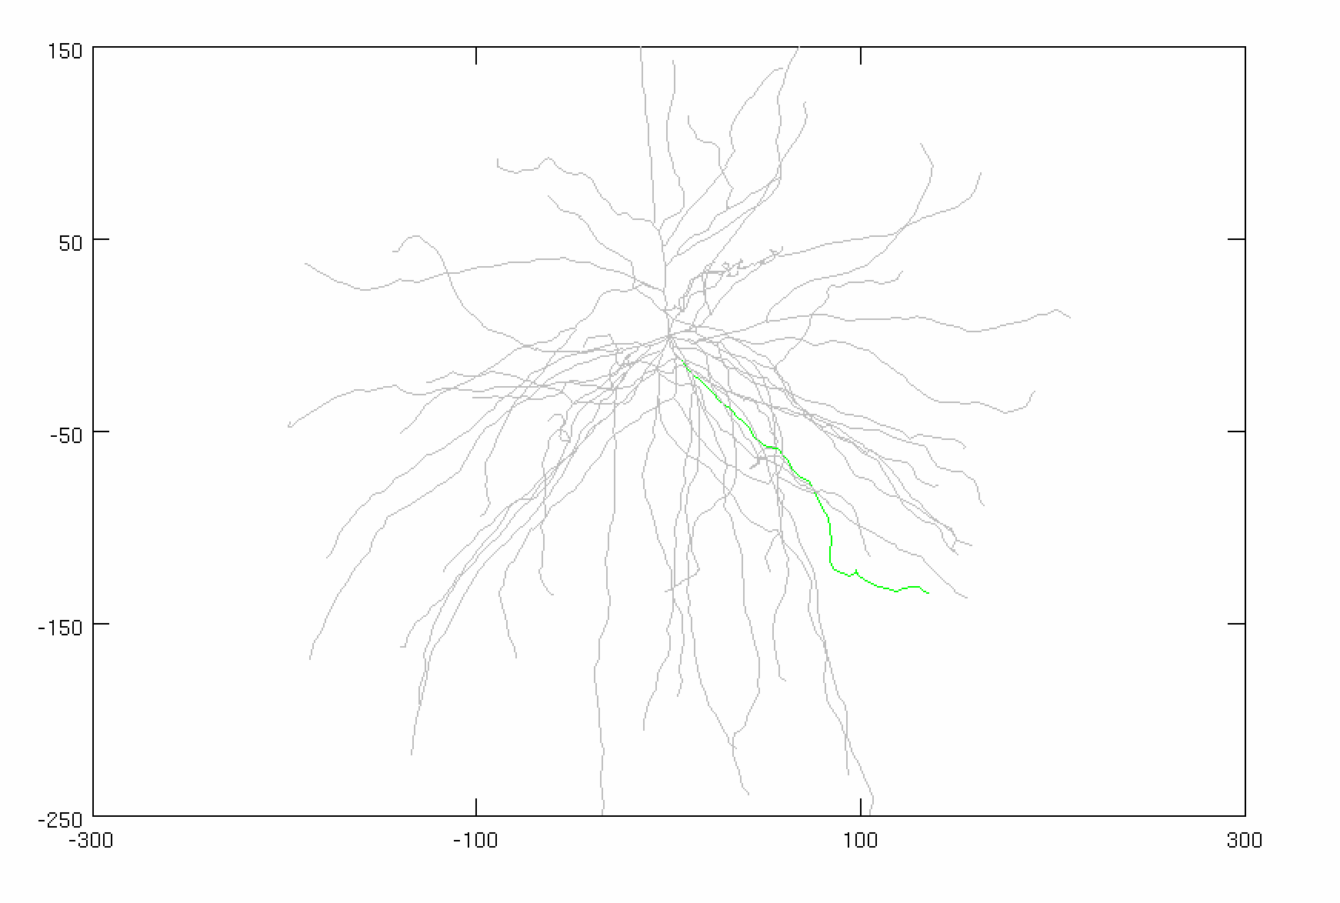
Parameters
Inhibitory Gamma
N_syn = 30 (ON SOMA)
Firing rate: 50 Hz
Distribution: 3 ms
Conductance: 0.005 µS
Adjusted Current
Amplitude: 1.895 nA
Noise: 0 nA
Stimulus
Total synapses: 40 synapses
AMPA: 0.0015 µS
NMDA: 0.0039 µS
Firing rate: 50 Hz
Start Time: 0 ms
Noise: 0 ms
Location: 50% of the dendrite (focal, synchronized))
AVG: 15 trials
CONSTANT
VARIABLE

Slide 4
FI Curve (Constant for All Trials)

Slide 5
Note on Voltage Traces
Due to how the stimulus objects were set up, it is necessary to visualize the voltage traces to see the phase of the excitatory and inhibitory signal. For better visualization, the following was done:
1. Excitation turns on at 200 ms
2. Noise was removed from inhibitory synapses
3. Current injection was removed to prevent APs
4. 40 excitatory synapses fire to exaggerate the effect
*This is just for visualization purposes

Slide 6
∆T = 0 ms Excitatory Shift
AT SOMA: Excitation fires ~2 ms after inhibition fires
AT DENDRITE: Excitation fires ~1 ms before inhibition fires

Slide 7
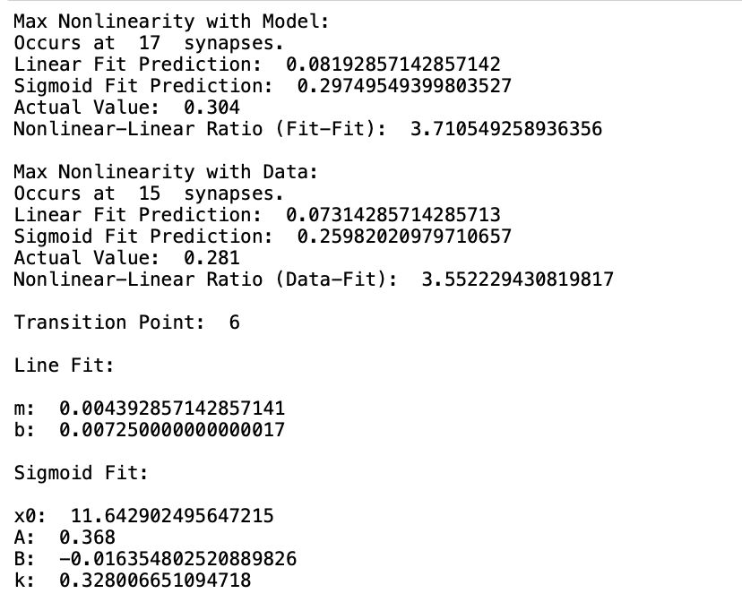
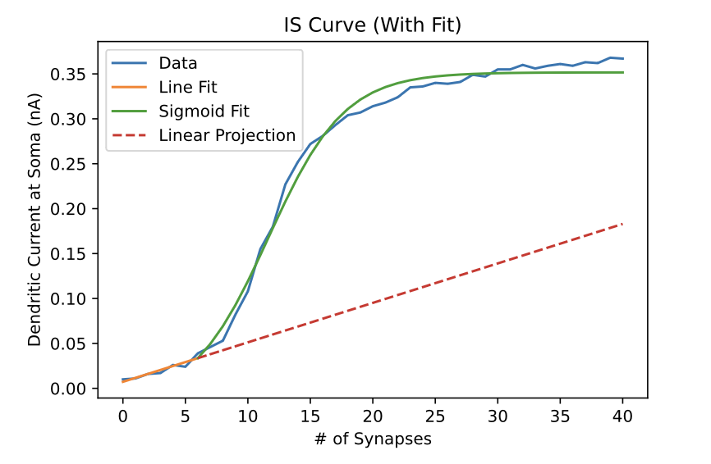
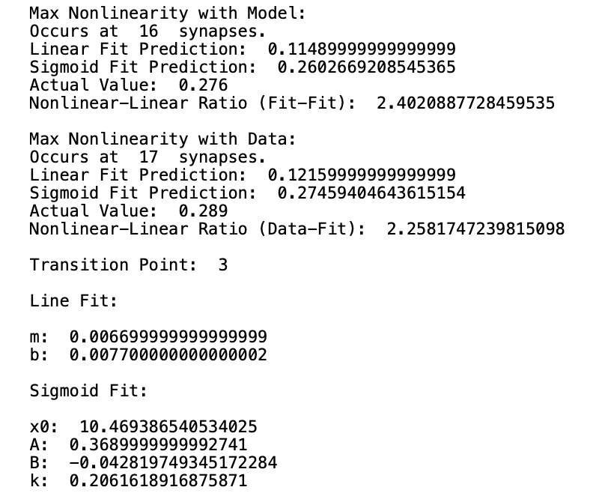
∆T = 0 ms Excitatory Shift

Slide 8
∆T = 5 ms Excitatory Shift
AT SOMA: Excitation fires at trough of inhibition (~5 ms)
AT DENDRITE: Excitation fires at trough of inhibition (~5 ms)

Slide 9
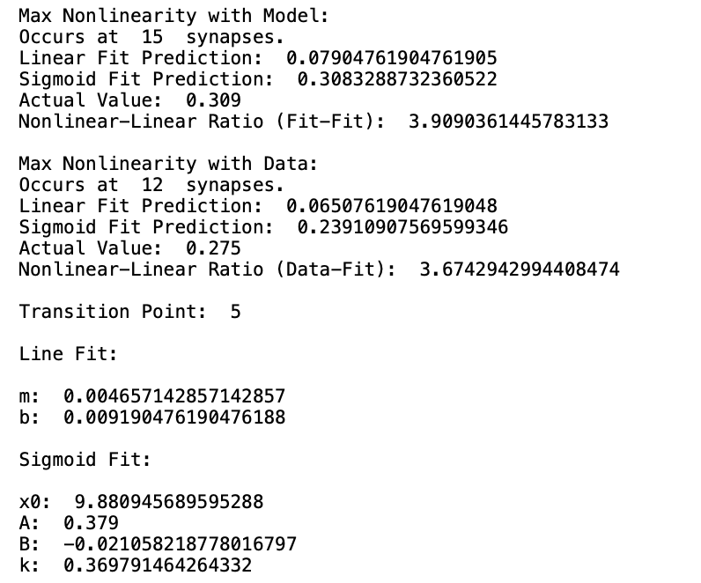
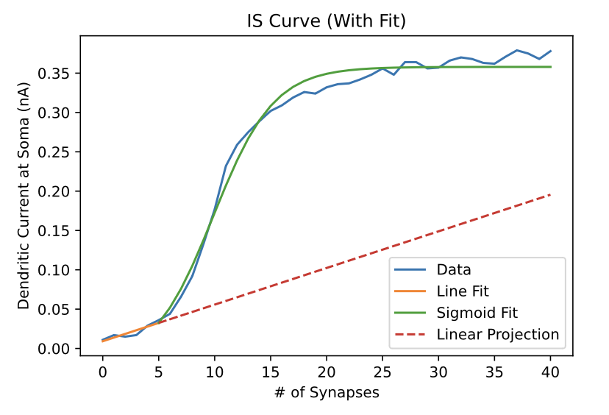
∆T = 5 ms Excitatory Shift

Slide 10
∆T = 10 ms Excitatory Shift
AT SOMA: Excitation fires on half-way through upswing of inhibition (~10 ms)
AT DENDRITE: Excitation fires on half-way through upswing of inhibition (~10 ms)

Slide 11
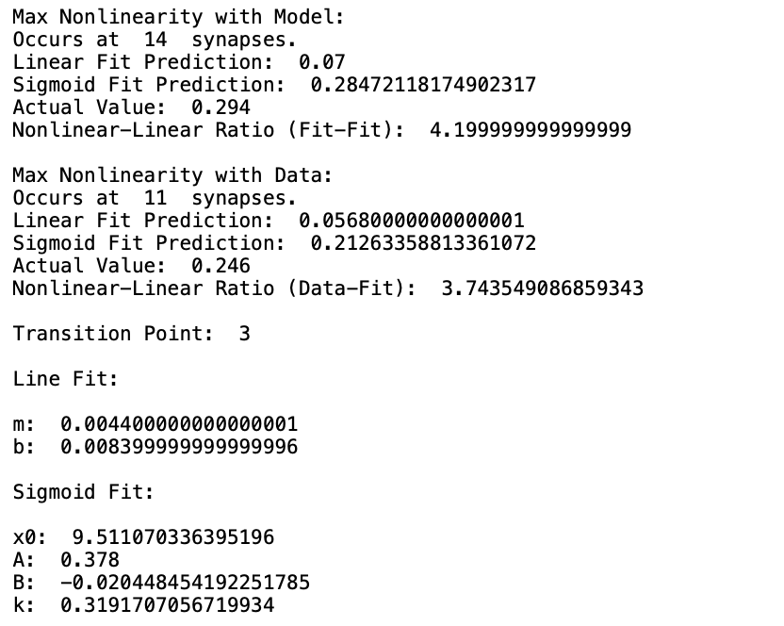
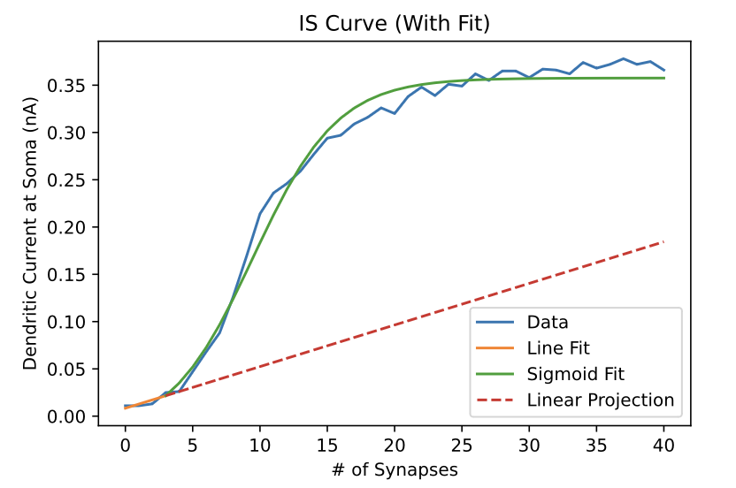
∆T = 10 ms Excitatory Shift

Slide 12
∆T = 15 ms Excitatory Shift
AT SOMA: Excitation fires (~5 ms) before inhibition
AT DENDRITE: Excitation fires (~5 ms) before inhibition

Slide 13
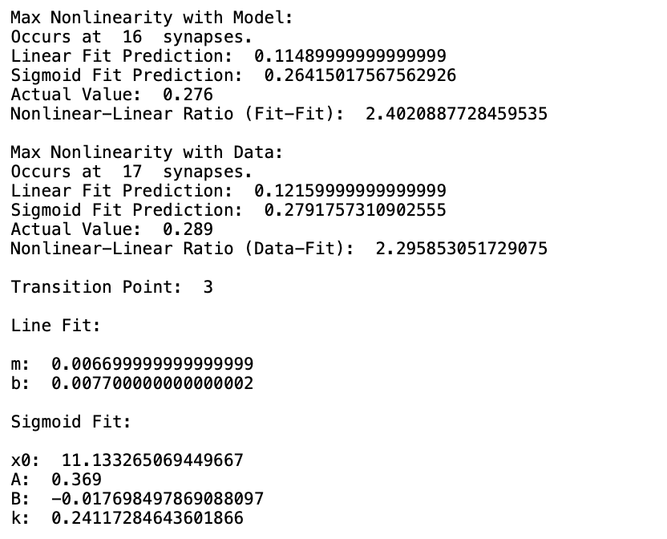
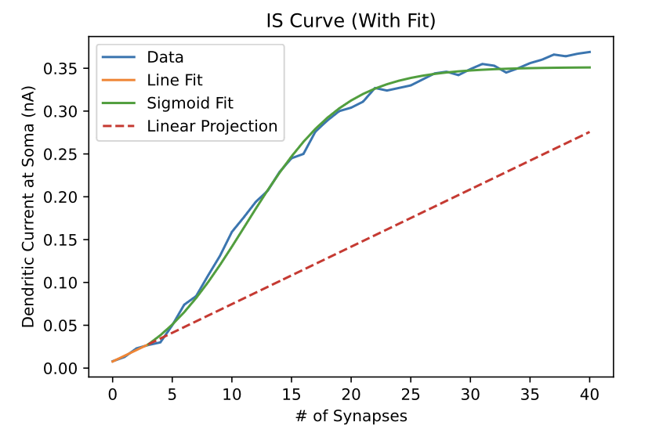
∆T = 15 ms Excitatory Shift

